Slide 1
Competitive Programming
30 Sep. 2022
Andrei Novikov

Slide 2
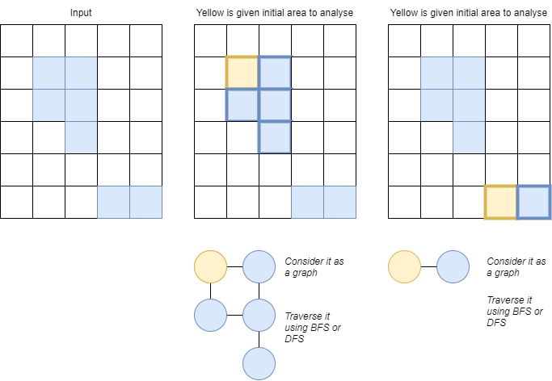
Revise homework #1
Book: “Competitive Programming 3”.
Chapter: 4.2.
Task: UVa 469 - Wetlands of
Florida - Link
Solution: Link

Slide 3
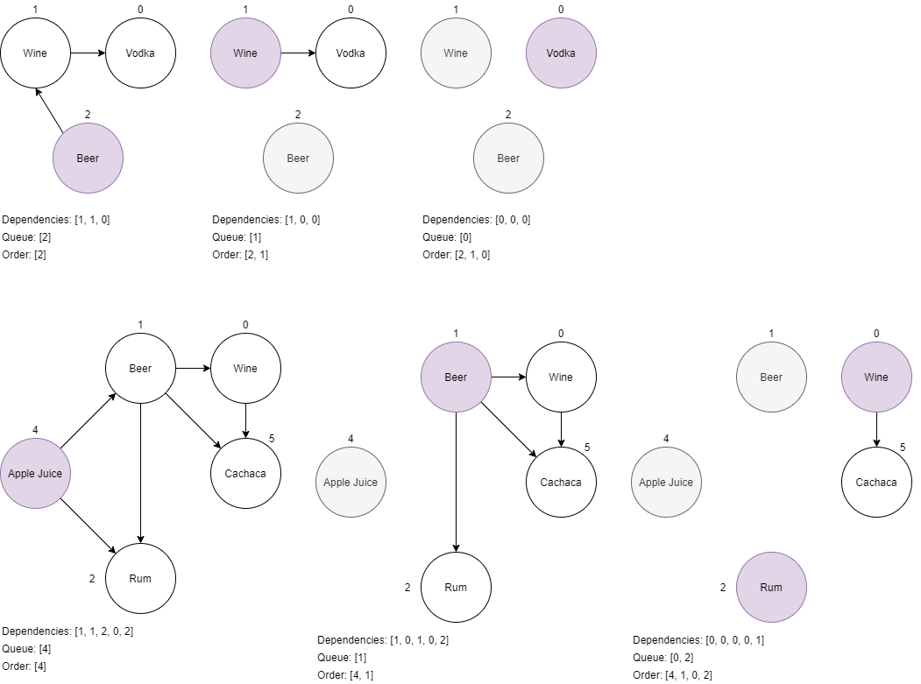
Revise homework #2
Book: “Competitive
Programming 3”. Chapter: 4.2.
Task: UVa 11060 –
Beverages – Link
Solution: Link

Slide 4
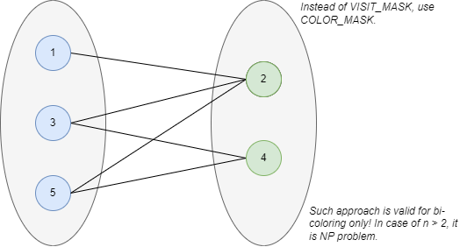
Revise homework #3
Book: “Competitive Programming 3”. Chapter: 4.2.
Task: UVa 10004 - Bicoloring – Link
Solution: Link
Where to read about N-coloring
problem (NP problem): Link to Wiki

Slide 5
Life Practice – Challenge #1
Topic: Graph
Resource: Leetcode – 207 Course Schedule

Slide 6
Life Practice – Challenge #2
Topic: Graph
Resource: Leetcode – 133 Clone Graph

Slide 7
Home task?
Competitive Programming 3:
4.2.7
4.2.8
4.2.9
UVa 11838 – Come and Go
UVa 00118 – Mutant Flatworld Explorers
UVa 00168 – Theseus and the...
UVa 00280 – Vertex

Slide 8




Where to Practice
LeetCode [link]
HackerRank [link]
Kattis [link]
TopCoder [link]
Other Resources

